Slide 1




Reinforcement Learning
Study Notes: From the basics to PPO and GRPO
• What is the reinforcement learning?
• What are PPO and GRPO?
• How is RL utilized in LLMs?
1

Slide 2
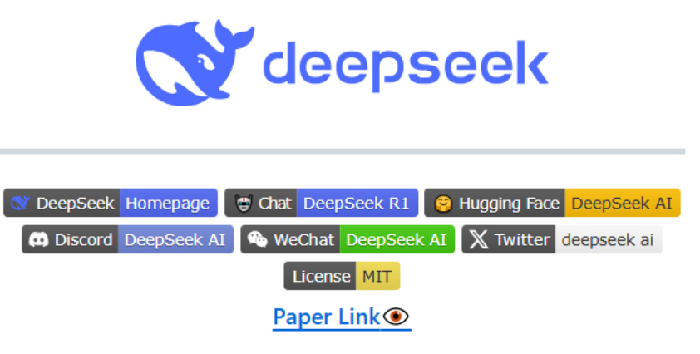
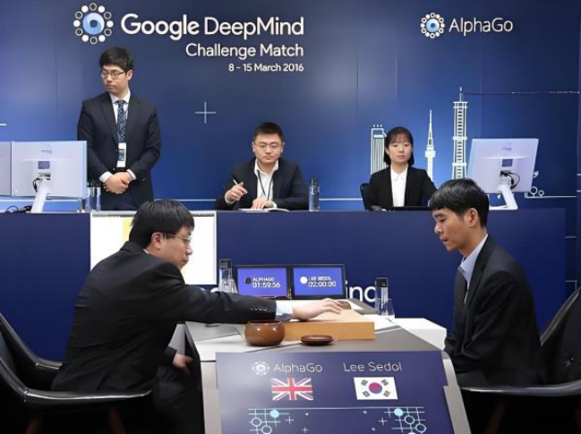
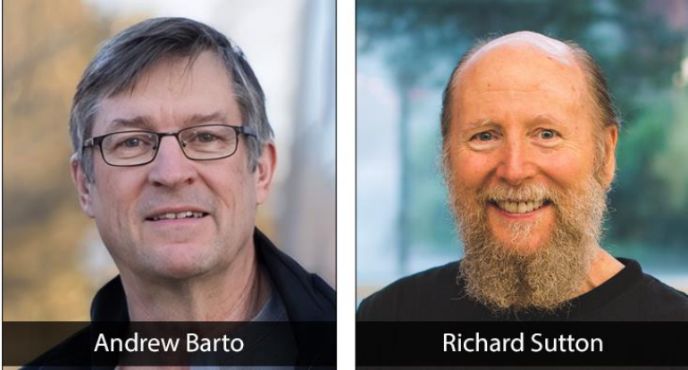
Reinforcement Learning
2025 Turing Award
2025 deepseek-R1
2016 AlphaGo
Reinforcement Learning
Xin Zhang
2

Slide 3


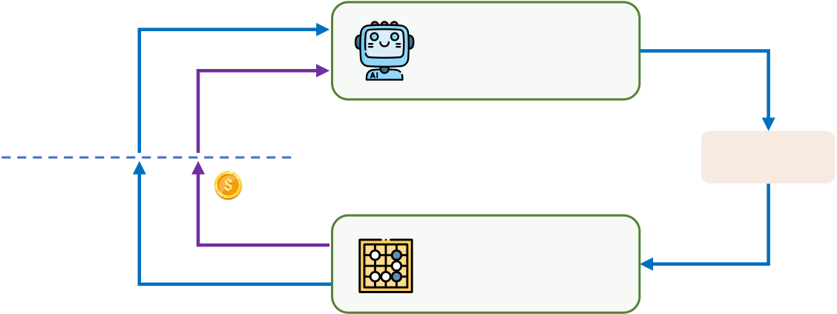






What is Reinforcement Learning
cat
0.9
1
agent
classifier
dog
0.1
0
state
action
…
next state
reward
bird
0.0
0
environment
Supervised Learning
Reinforce Learning
labeled data
Interaction
Find a model to fit the mapping.
Find a policy to maximize the reward.
Reinforcement Learning
Xin Zhang
3

Slide 4
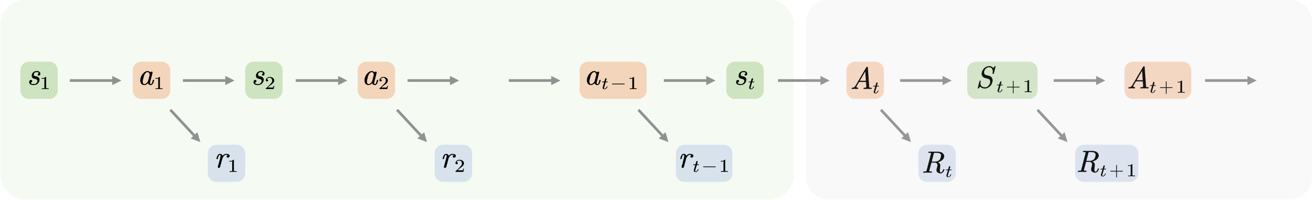






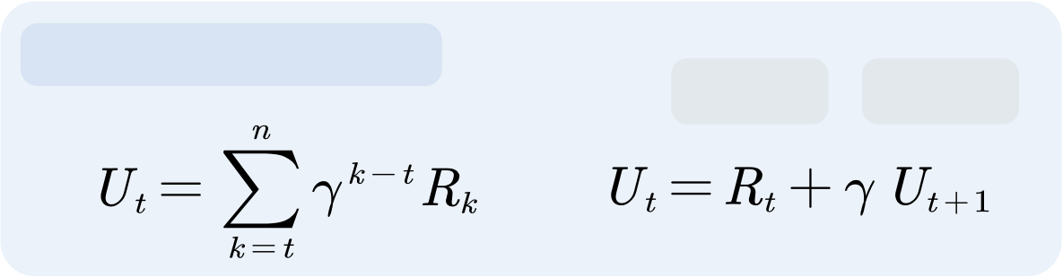
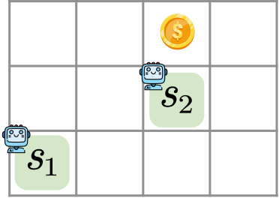

Markov Decision Process
observed value
unknown variable
action
…
…
state
reward
Return
…
…
Return (next state)
…
…
Discounted Return
Immediate
Future
rewards
rewards
Reinforcement Learning
Xin Zhang
4

Slide 5
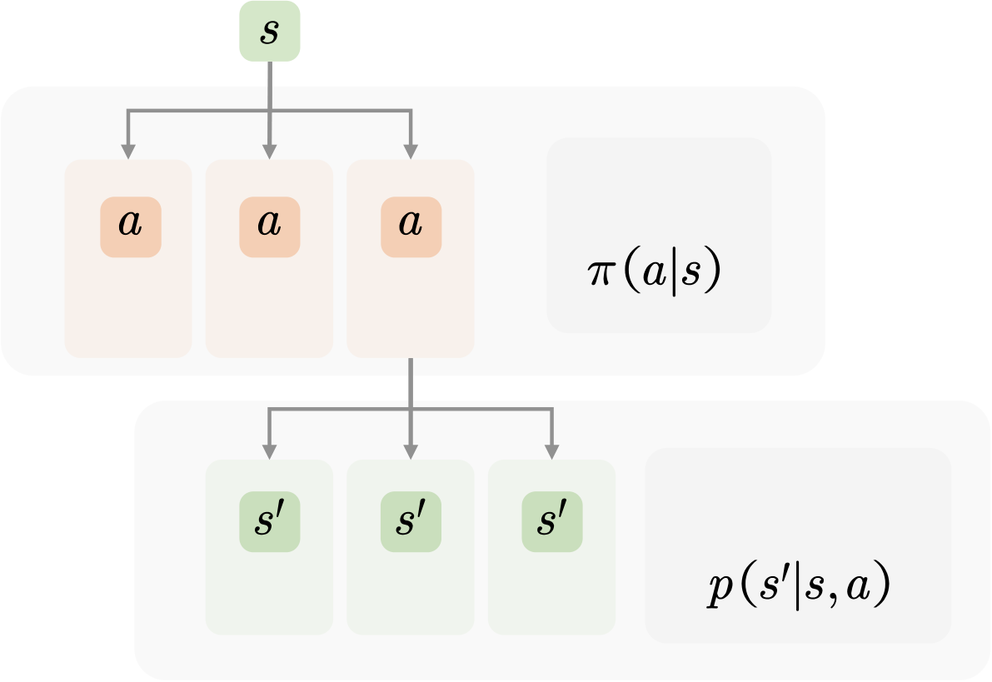



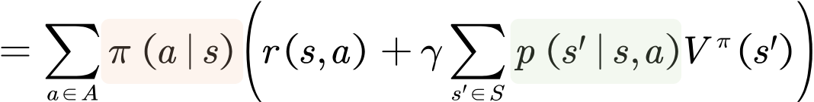



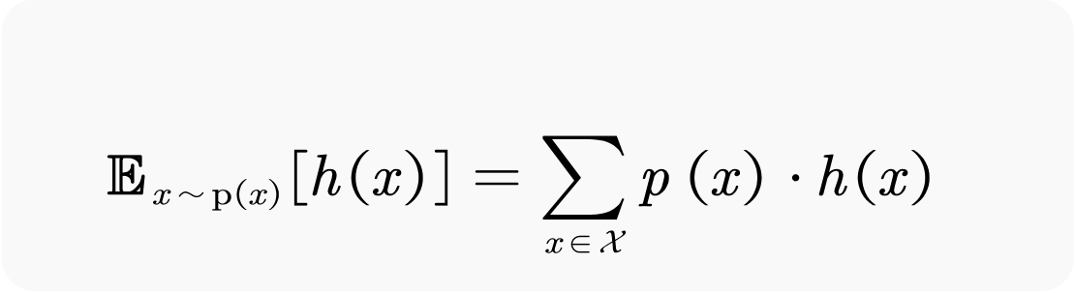
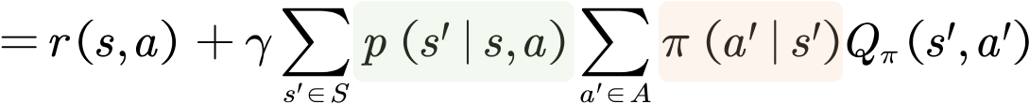

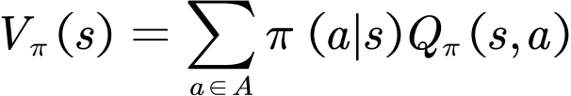
Randomness and Expectation
state value
Bellman Equation
🎲
policy
right
left
up
(0.1)
(0.7)
(0.2)
🎲
action value
Bellman Equation
state transition
(0)
(0.8)
(0.2)
Expectation
relationship
Reinforcement Learning
Xin Zhang
5

Slide 6
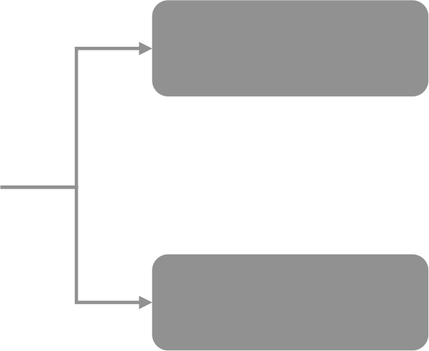
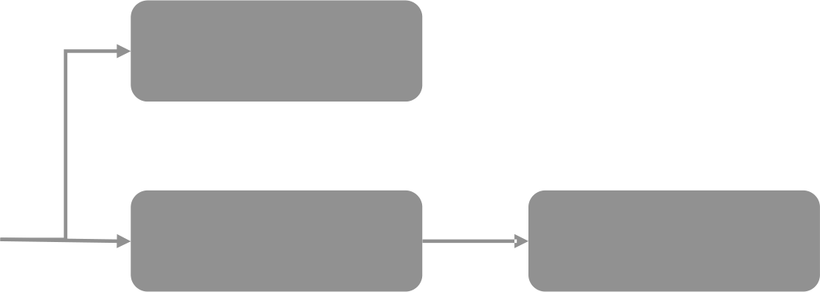
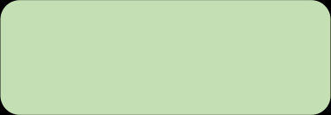



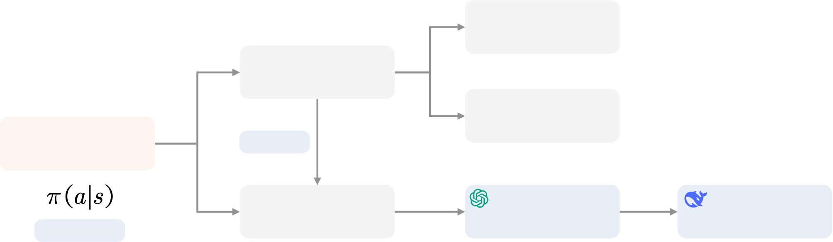

The Top-Down Framework
Monte Carlo
SARSA
value-based
off-policy and on-policy
Temporal
Q-learning
DQN
evaluate
Difference
REINFORCE
Policy Gradient
Actor-Critic
policy-based
intuition
TRPO
PPO
GRPO
probability
Math
R1
Reinforcement Learning
Xin Zhang
6

Slide 7


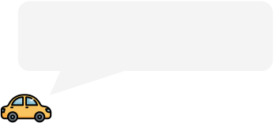







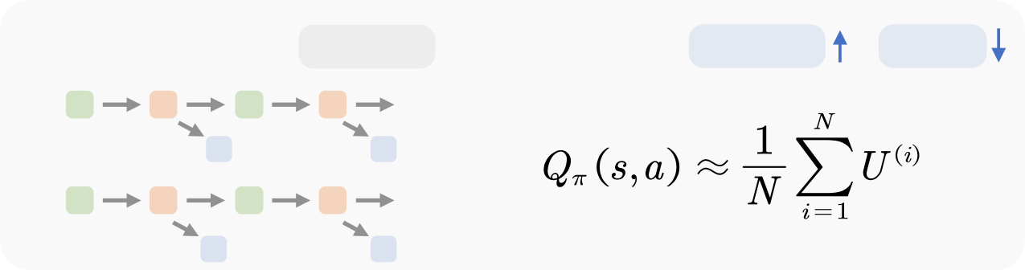



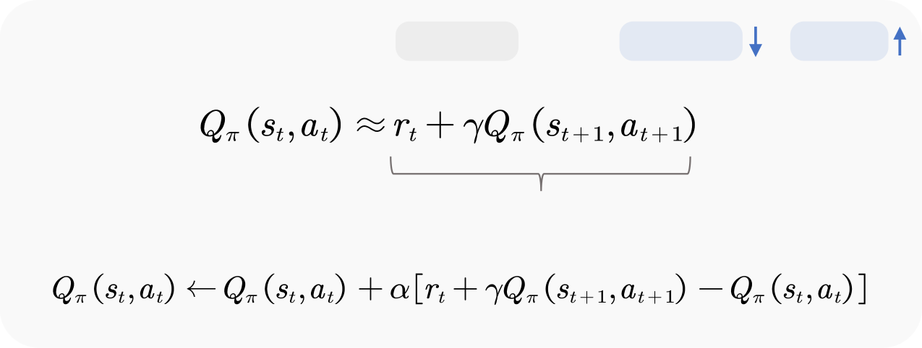


Temporal Difference
How to estimate
About 30min
1 Monte Carlo
multi-step
variance
bias
About 20min
…
…
…
Ideal
10 min
About 18min
2 Temporal Difference
one-step
variance
bias
realistic
10 min
TD target
28min is more
accurate
Reinforcement Learning
Xin Zhang
7

Slide 8
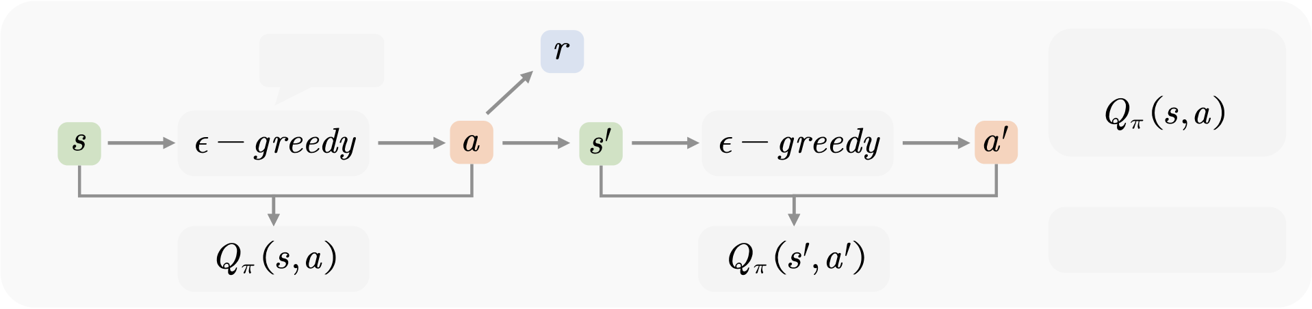



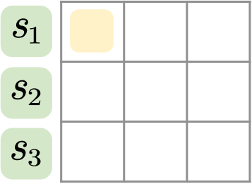
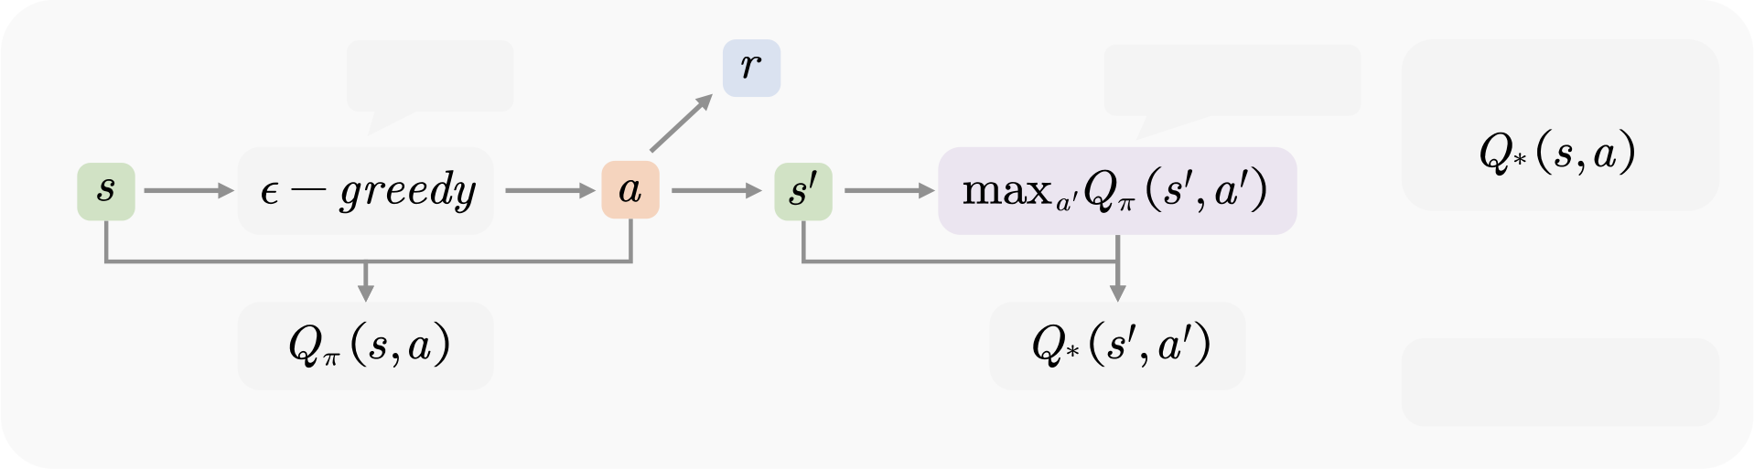
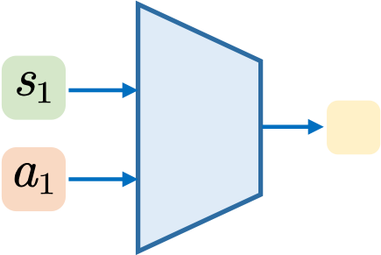
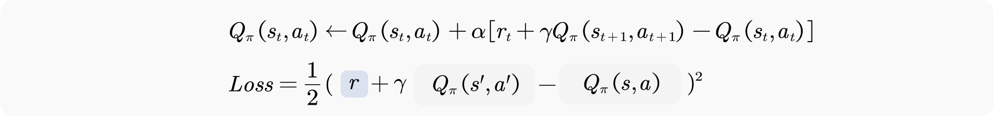
SARSA and Q-learning
SARSA
A policy
obtain
23
on-policy
Table Query
(SARSA, Q-Learning)
Q-Learning
A policy
another policy
obtain
NN
23
off-policy
behavior policy
target policy
Neural Network
Table Update:
(DQN)
NN Update:
Reinforcement Learning
Xin Zhang
8

Slide 9



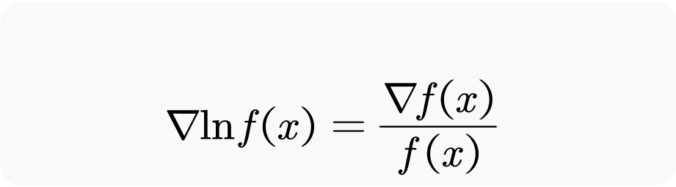









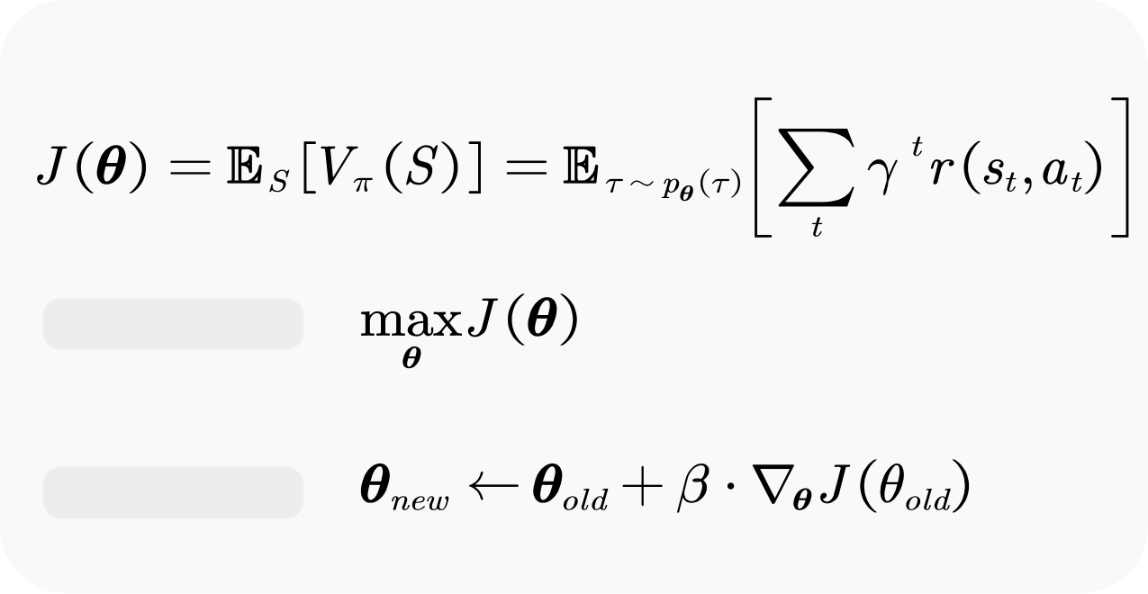



Policy Gradient
0.2
Differentiate a composite function
SoftMax
0.4
NN
0.1
0.3
Maximize the return
Ignore one item
Optimization
Gradient Ascent
random gradient
Reinforcement Learning
Xin Zhang
9

Slide 10
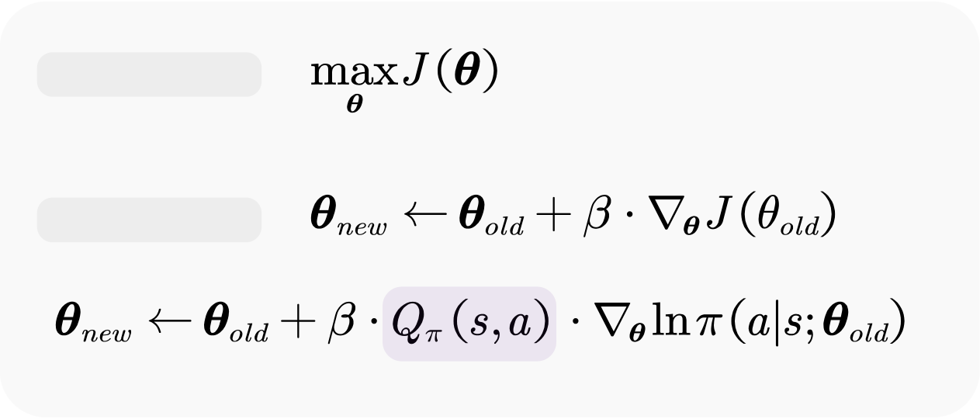
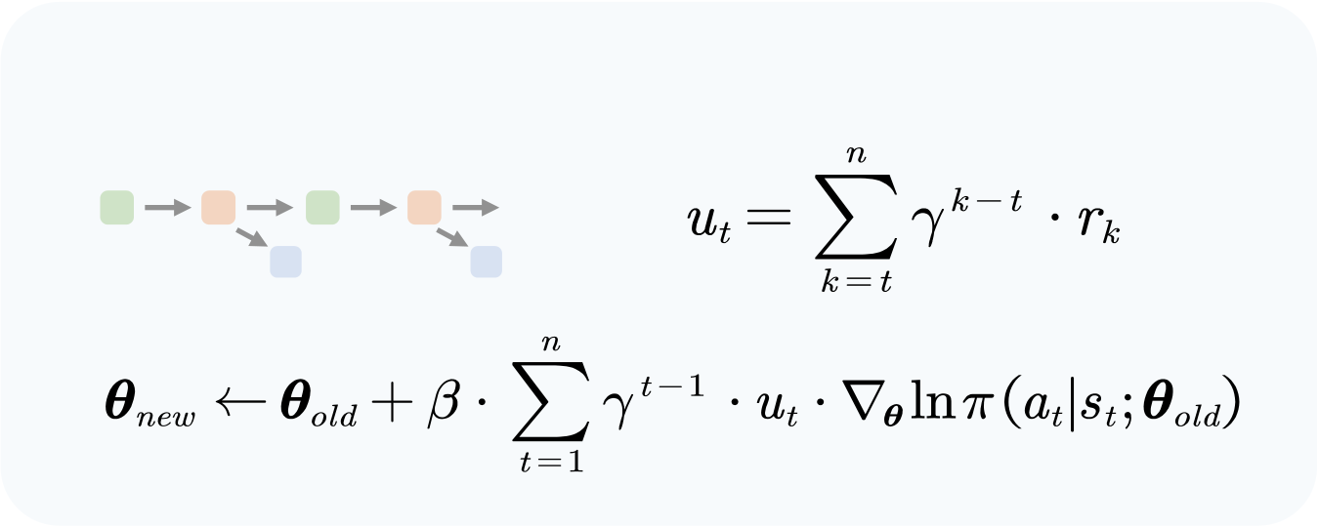
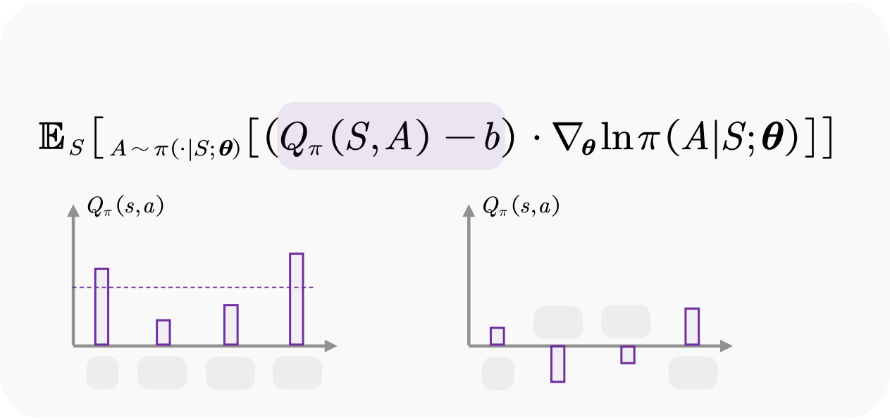
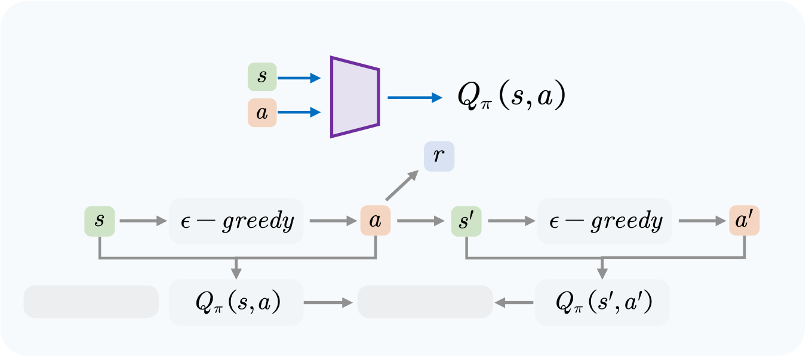
REINFORCE and Actor-Critic
Optimization
REINFORCE
…
Gradient Ascent
Baseline Actor-Critic
NN
50
60
20
30
10
20
down
left
up
down
left
right
up
right
update actor
update critic
-20
-10
Reinforcement Learning
Xin Zhang
10

Slide 11
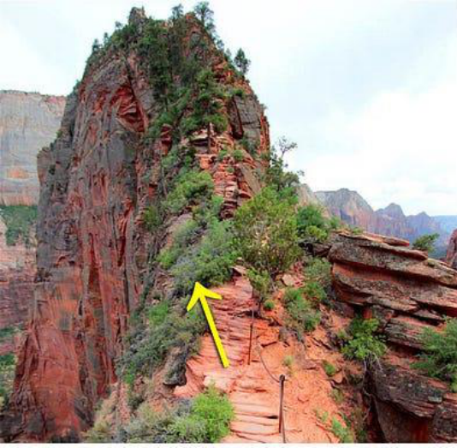
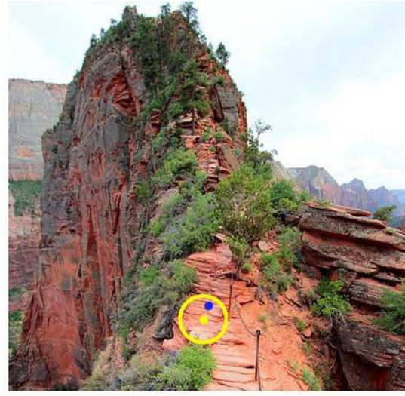
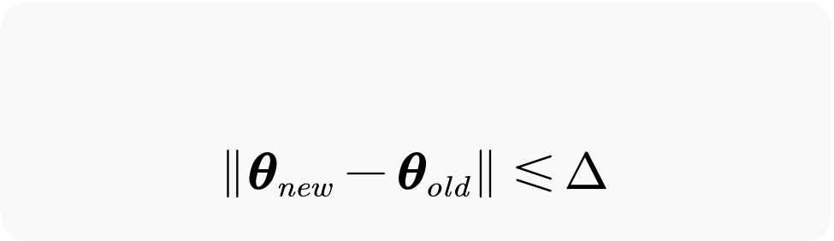

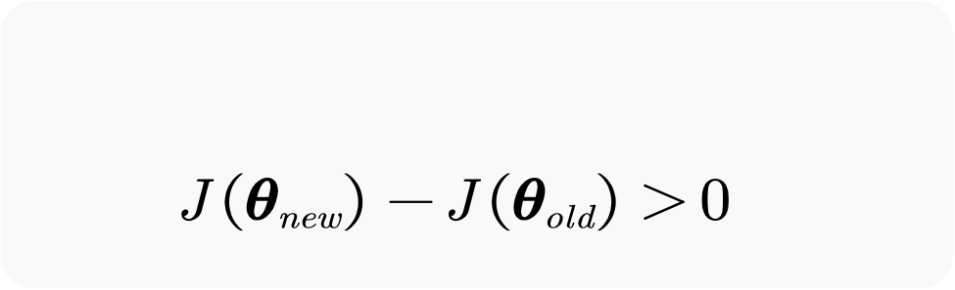
The Problem of Policy Gradient
Trust region
A new policy is better
Difficulty in setting the step size for updates.
Reinforcement Learning
Xin Zhang
11

Slide 12



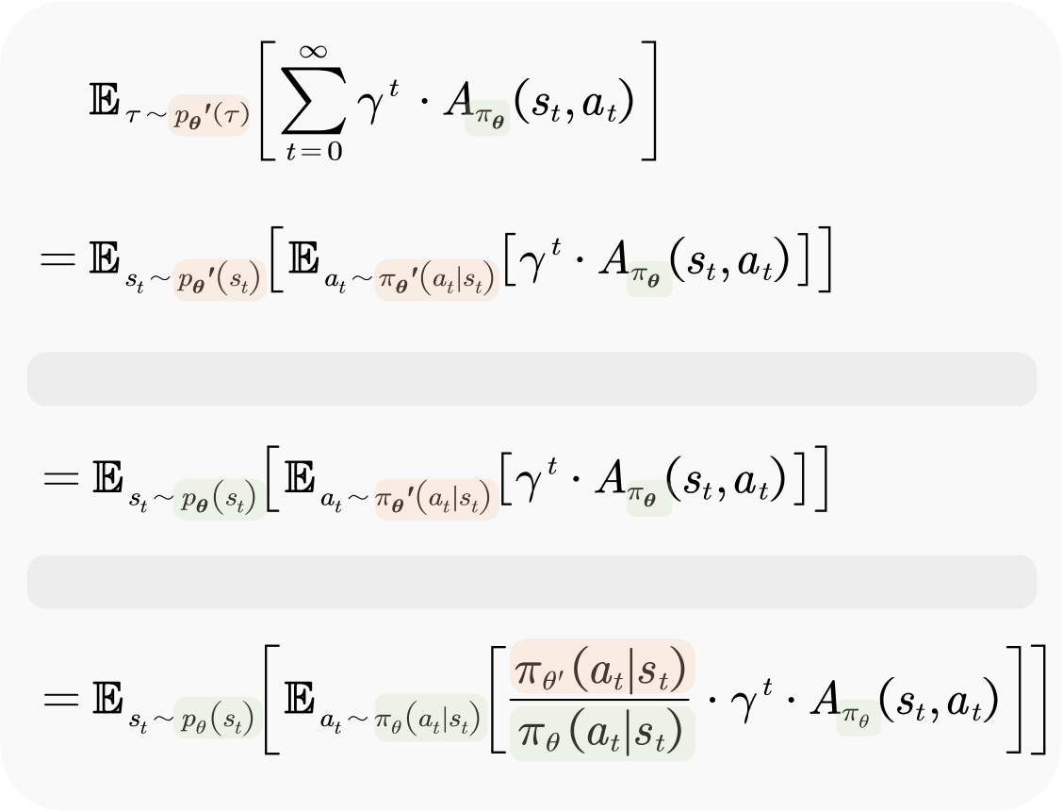

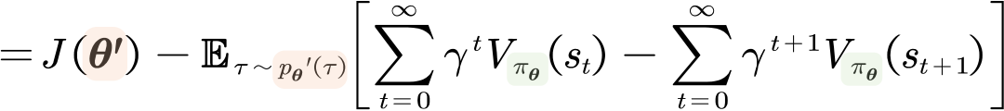
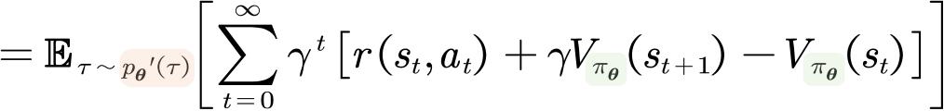
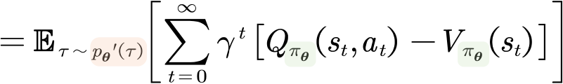
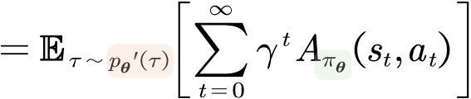
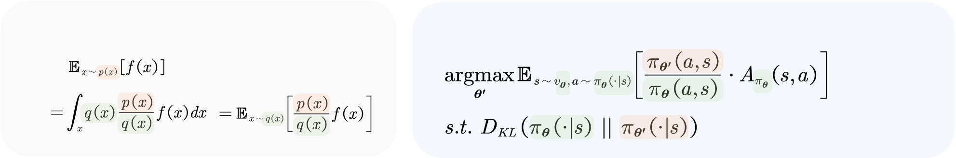

Trust Region Policy Optimization
new policy old policy
initial state unchanged
Approximation 1: Ignoring the changes in the state distribution.
Approximation 2: Importance sampling.
Importance Sampling TRPO
Advantage function
Reinforcement Learning
Xin Zhang
12

Slide 13
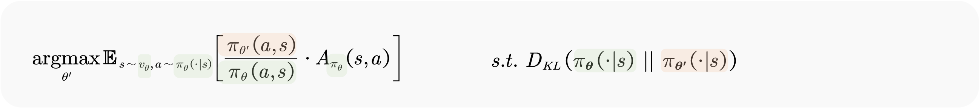
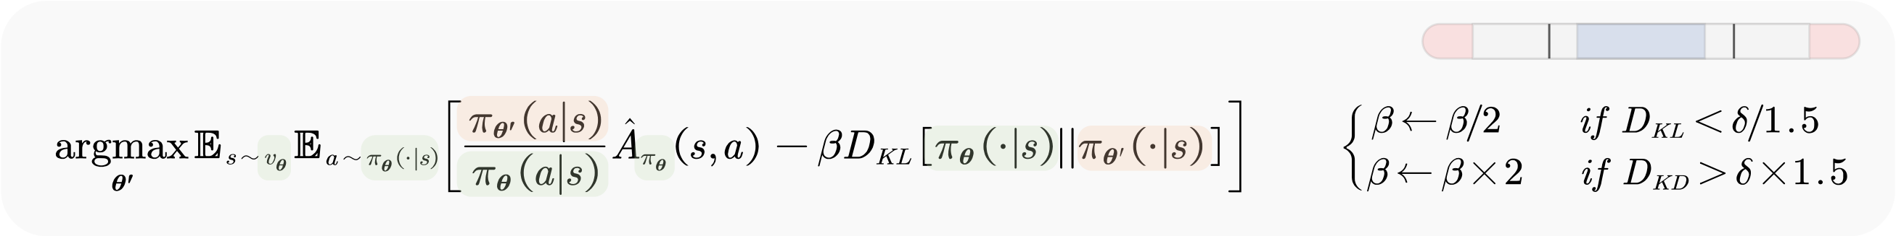
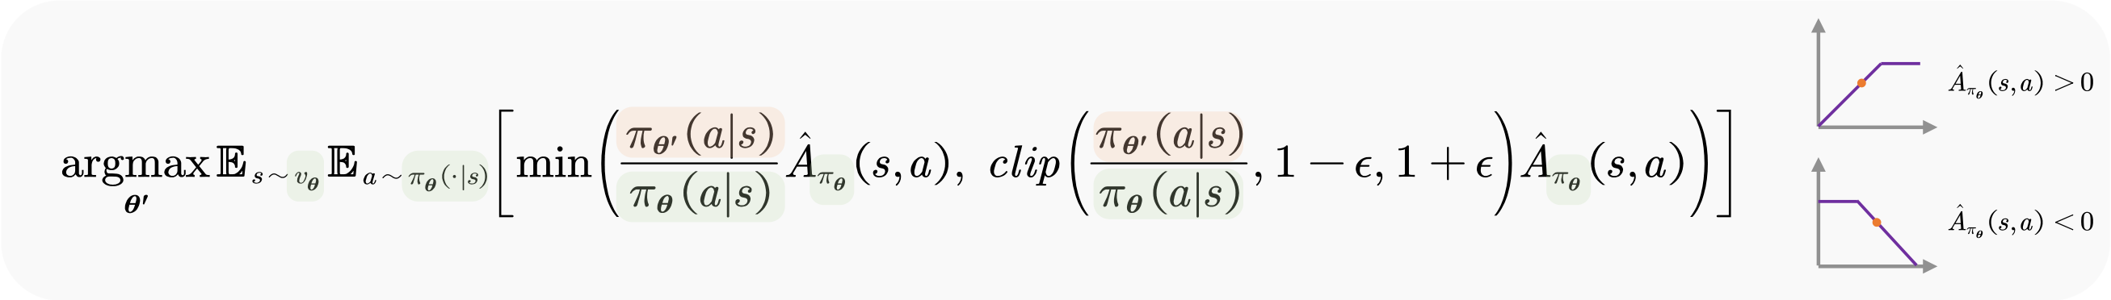
Proximal Policy Optimization
TRPO
PPO-penalty
PPO-clip
Reinforcement Learning
Xin Zhang
13

Slide 14









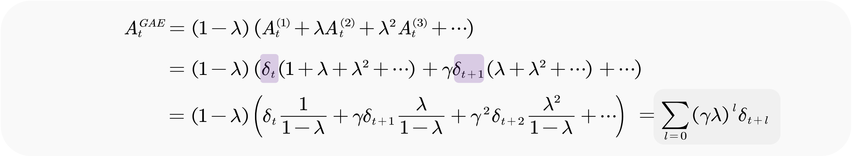
Generalized Advantage Estimation
1 Monte Carlo
multi-step
variance
bias
Multi-Step Temporal Difference
2 Temporal Difference
one-step
variance
bias
Reinforcement Learning
Xin Zhang
14

Slide 15

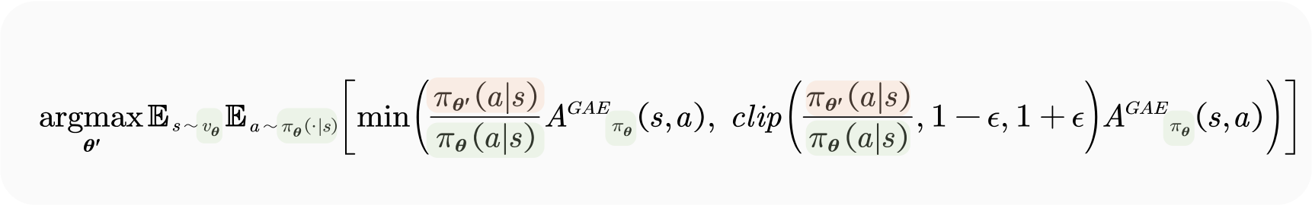








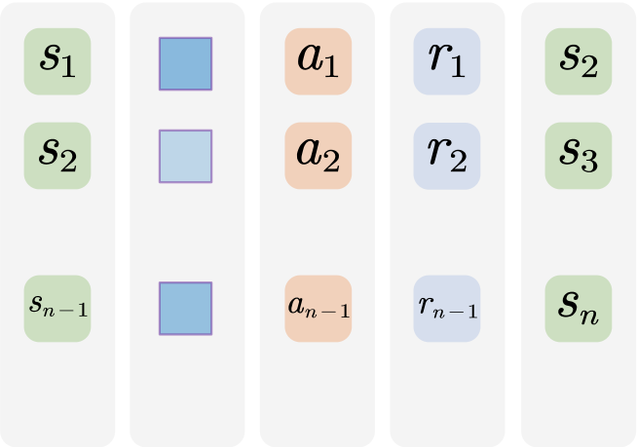
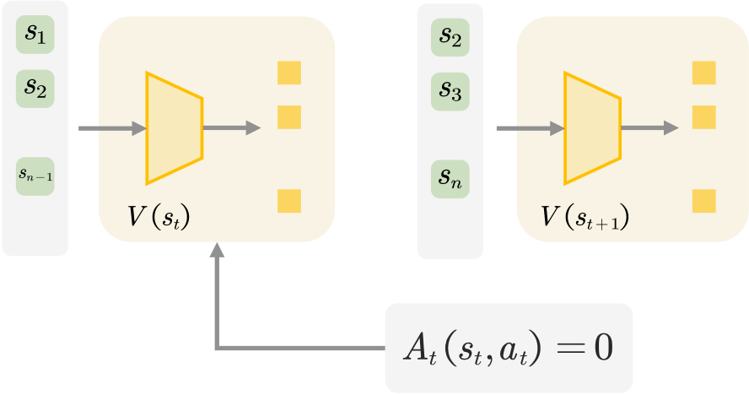
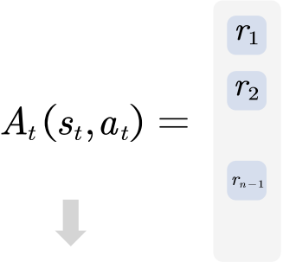


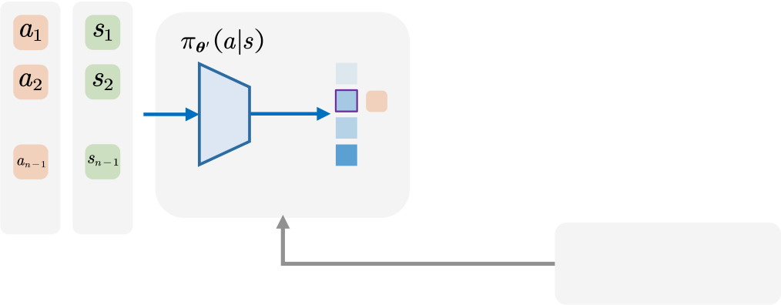


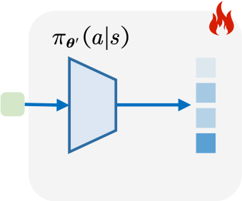



Training Process of PPO
PPO-clip
SoftMax
…
old
old policy
…
…
…
…
…
…
…
…
…
…
state
next
reward
state
backward
state
old
action
reward
next
probs
state
SoftMax
…
…
new
SoftMax
…
…
new
new policy (actor)
value (critic)
new policy (actor)
new
old
action
state
backward
probs
probs
PPO
Reinforcement Learning
Xin Zhang
15

Slide 16

Large Language Model
my
cat
logits [1, vocab_size]
…
…
logits [1,vocab_size]
…
…
…
output [1,d]
output [1,d]
Linear [d,1]
Causal Language Model
Causal Language Model
embedding [1,d]
embedding [1,d]
word
I
love
word
I
love
my
Reinforcement Learning
Xin Zhang
16

Slide 17





How To Train A Reward Model
Bradley-Terry
win
lose
A vs. B
8
4
A vs. C
3
5
B vs. C
2
3
Maximum Likelihood Estimation
LM
reward model
Reinforcement Learning
Xin Zhang
17

Slide 18














Training Process of PPO in LLM
probs
probs
ref model
[1,vocab_size]
reward model
value model
reward
value
Causal Language Model
probs
policy model
value
GAE
KL
reward
reward
KL
18

Slide 19

















Group Relative Policy Optimization
Model(Math) | Rule(R1)
Causal Language Model
prompt
completions
rewards
advantages
_get_per_token_logps()
new_per_token_logps
old_per_token_logps
ref_per_token_logps
19

Slide 20














Review the PPO and GRPO
PPO
policy ref
model model
reward value
model model
GRPO
policy ref
model model
reward
model
20

Slide 21
Reference
1. 王树森,黎彧君,张志华. 深度强化学习. 人民邮电出版社, 2022. https://github.com/wangshusen/DRL
2. 张伟楠,沈键,俞勇.动手学强化学习. 人民邮电出版社, 2022. https://github.com/boyu-ai/Hands-on-RL
3. Sutton R S, Barto A G. Reinforcement learning: An introduction. Cambridge: MIT press, 1998.
4. Shao Z, Wang P, Zhu Q, et al. Deepseekmath: Pushing the limits of mathematical reasoning in open language models. arXiv, 2024.
5. Guo D, Yang D, Zhang H, et al. Deepseek-r1: Incentivizing reasoning capability in llms via reinforcement learning. arXiv, 2025.
6. Schulman J, Wolski F, Dhariwal P, et al. Proximal policy optimization algorithms. arXiv, 2017.
7. Schulman J, Levine S, Abbeel P, et al. Trust region policy optimization. ICML, 2015.
8. Stiennon N, Ouyang L, Wu J, et al. Learning to summarize with human feedback. NeurIPS, 2020.
9. https://github.com/huggingface/trl

